Slide 1
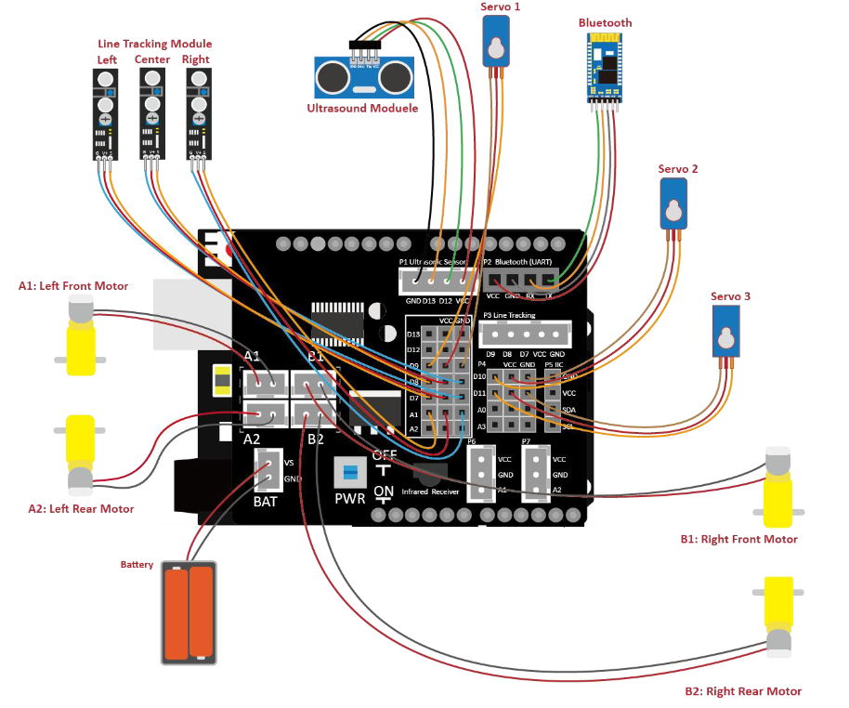
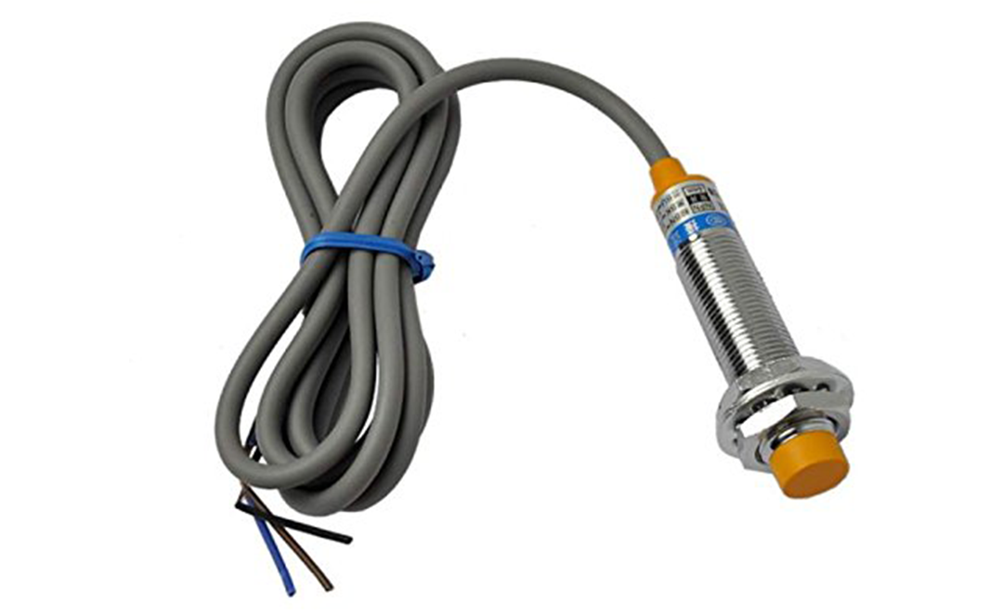

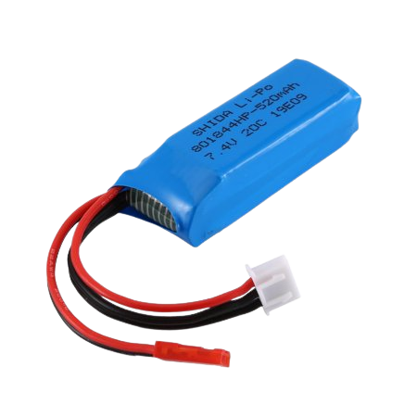
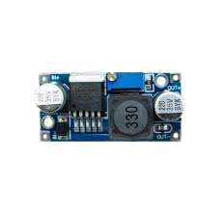
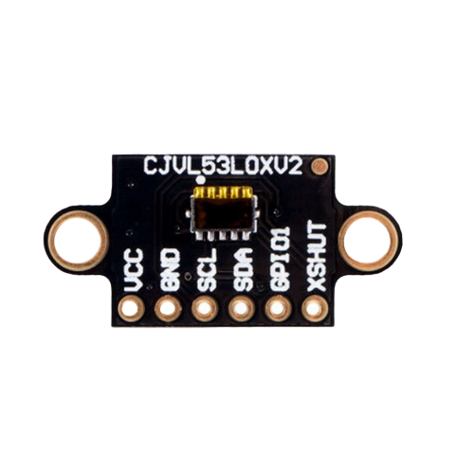
Capacitive Proximity Sensor
Inductive Proximity Sensor
12v Battery
DC-DC Converter
TOF Sensor

Slide 2
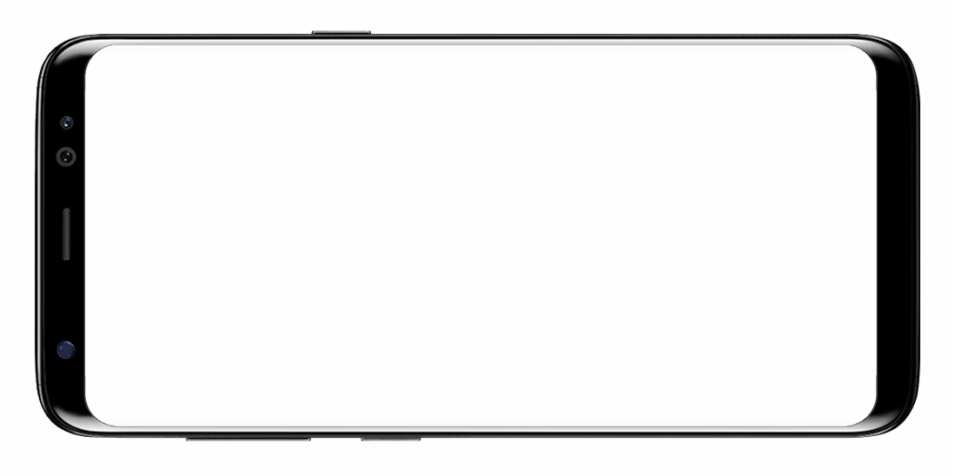

RoboSort Controller
AUTO PICK
USER-GUIDED MODE
LINE TRACKING
MODE

Slide 3
USING “USER-GUIDED MODE” (DEFAULT)
RoboSort Controller
AUTO PICK
USER-GUIDED MODE
LINE TRACKING
MODE

Slide 4
USING “LINE TRACKING MODE”
RoboSort Controller
AUTO PICK
USER-GUIDED MODE
LINE TRACKING
MODE

